Slide 1
1
PRODUCTION
PRODUCTION
BUSINESS
INDUSTRIAL PRODUCTION
SYSTEMS
PRESENTED BY:
GURUH SUKMO

Slide 2

Problems
unpredicted downtime of machines
reactive quality control, not proactive
data is scattered in some systems
hard to identify bottleneck
maintenance cost is not optimal
REASONS CHOOSING THIS PROJECT
Wy this matters?
Operational: 25% efficiency improvement
Strategic: Competitive advantage via Industry 4.0
Sustainability: Reduce waste & energy use
Impact finansial

Slide 3
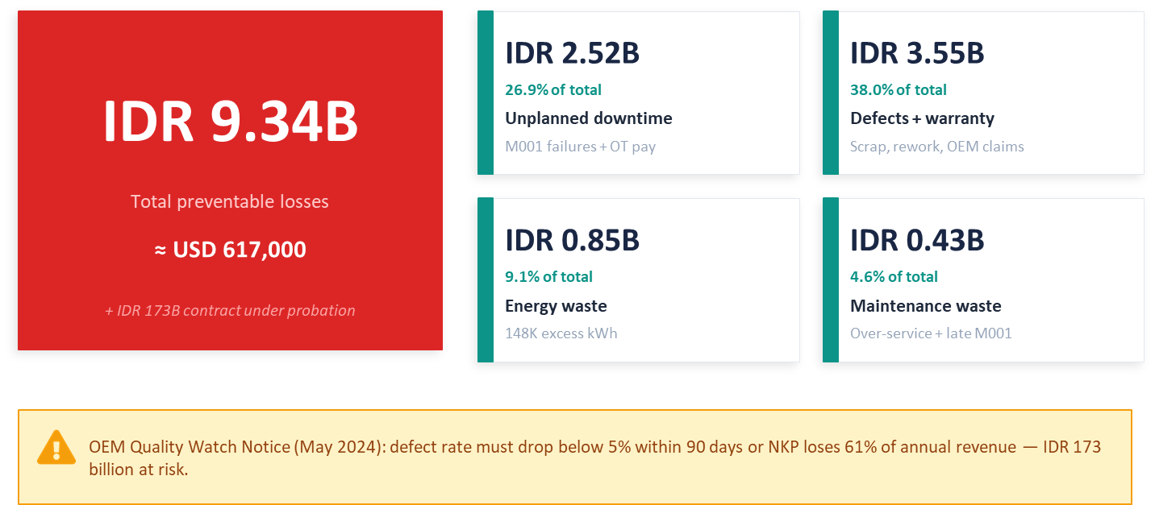
FINANCIAL LOSSES
2

Slide 4
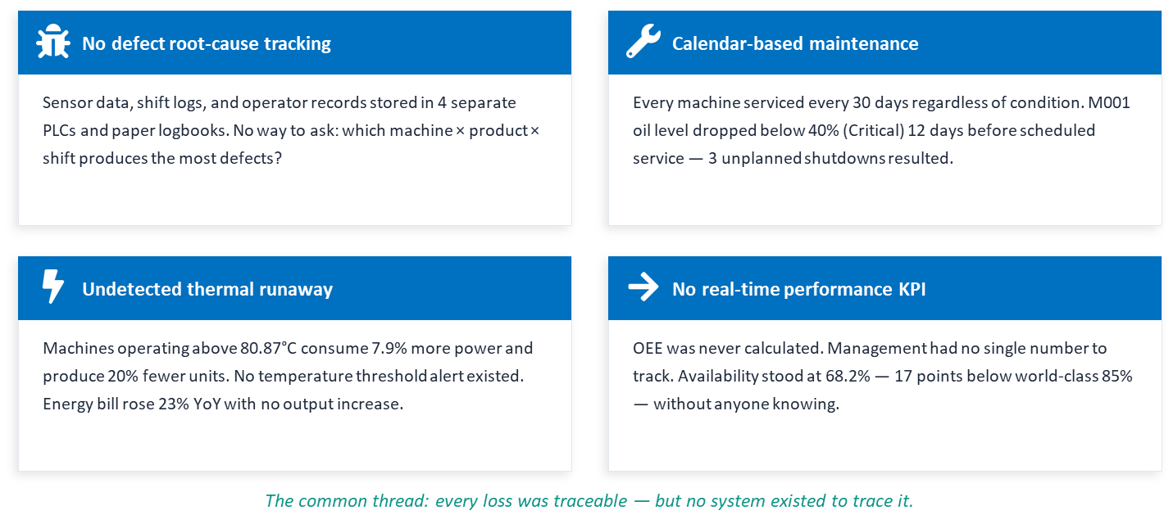
WHY THE LOSSES KEPT GROWING

Slide 5
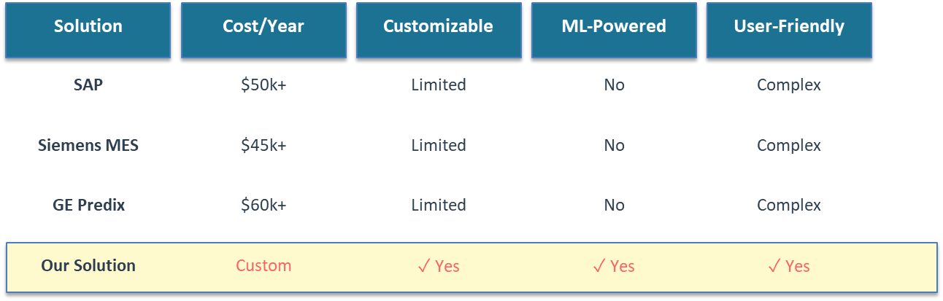
COMPETITIVE POSITIONING AND IDENTIFICATION GAP
7
Identified Gaps:
Lack of Integration: No fully integrated open-source solution available
Cost Barrier: Enterprise solutions are too expensive for SMEs
Limited Insights: Dashboards exist, but lack ML-powered predictions
User Experience: Complex interfaces, difficult for non-technical users
Our Advantages: Affordable, Customizable, Predictive, User-Friendly

Slide 6
OEE Quantification
Machine Condition Clustering
OUR SOLUTION
Defect Risk Prediction
Integrated Production
Analytics
Identify Bottleneck

Slide 7
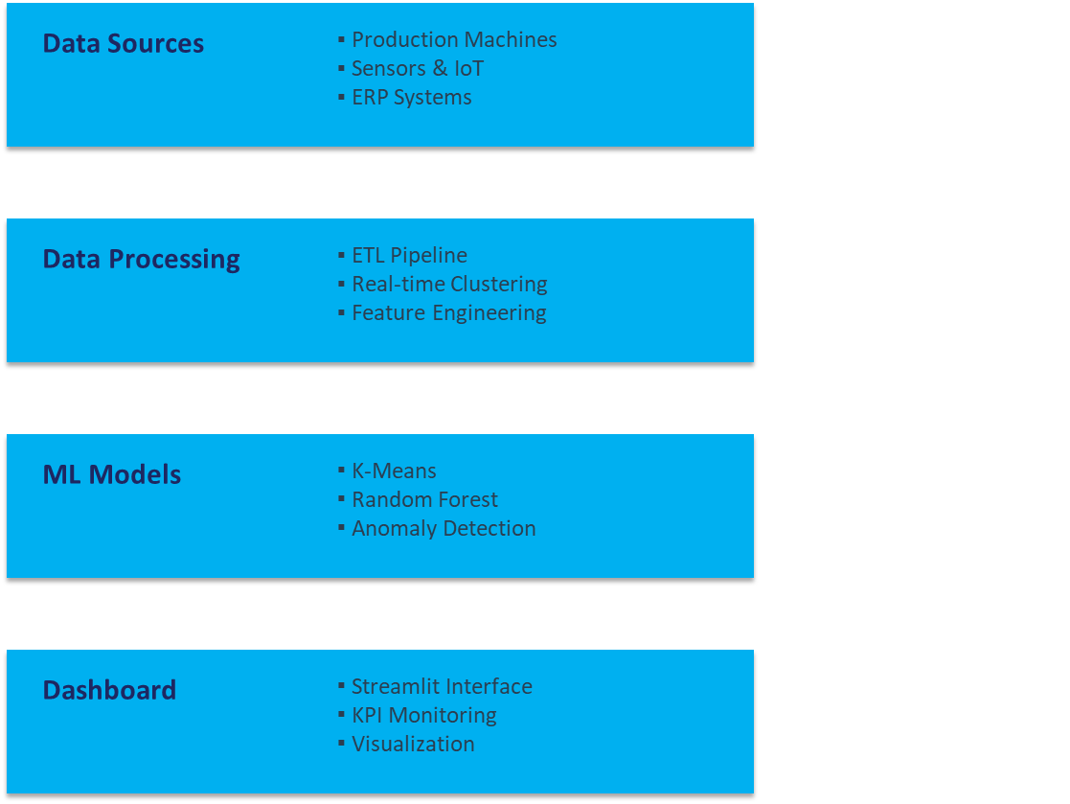
TECHNICAL ARCHITECTURE

Slide 8
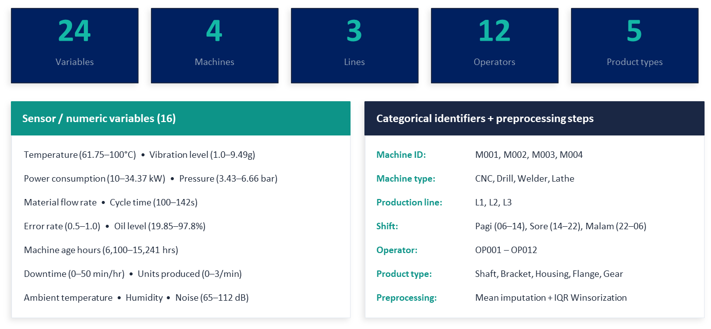
DATA WE USED

Slide 9
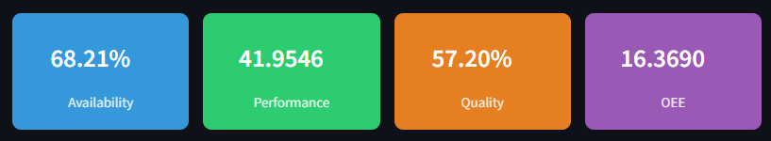
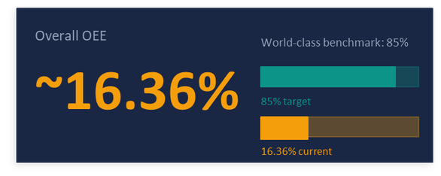
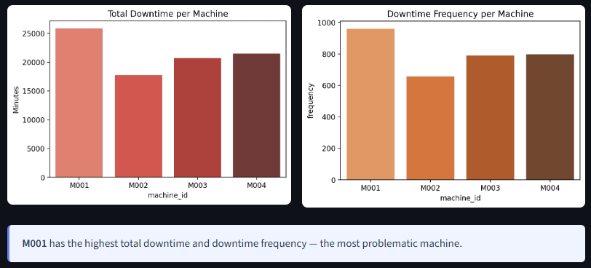
KEY FINDING 1 - KPI AND PERFORMANCE METRICS

Slide 10
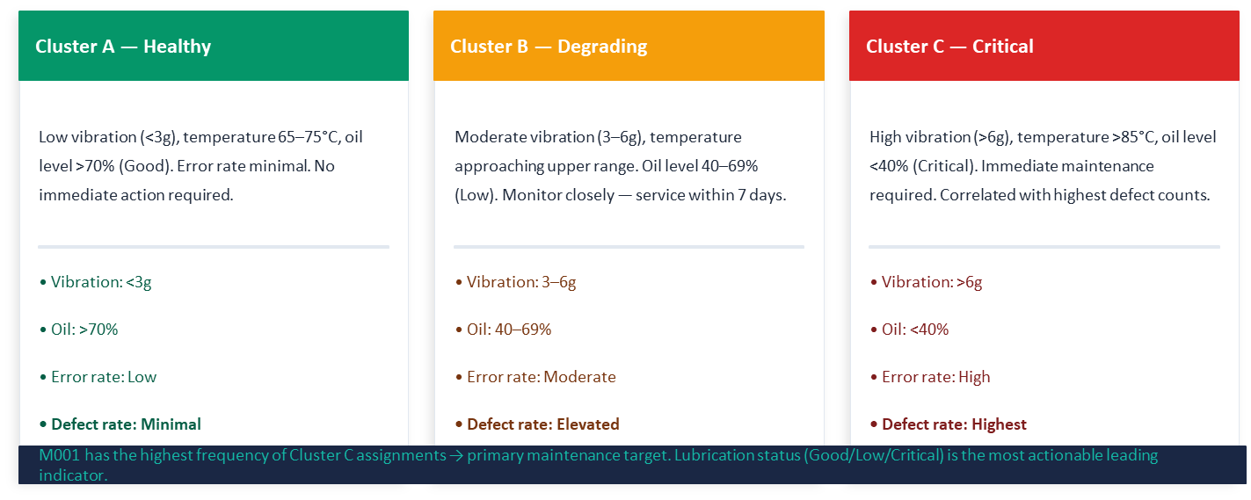
KEY FINDING 2 - MACHINE CONDITION CLUSTERING
KMeans applied to 8 sensor dimensions. Elbow method determined optimal cluster count. Each machine observation assigned a condition label — enabling proactive maintenance targeting.

Slide 11
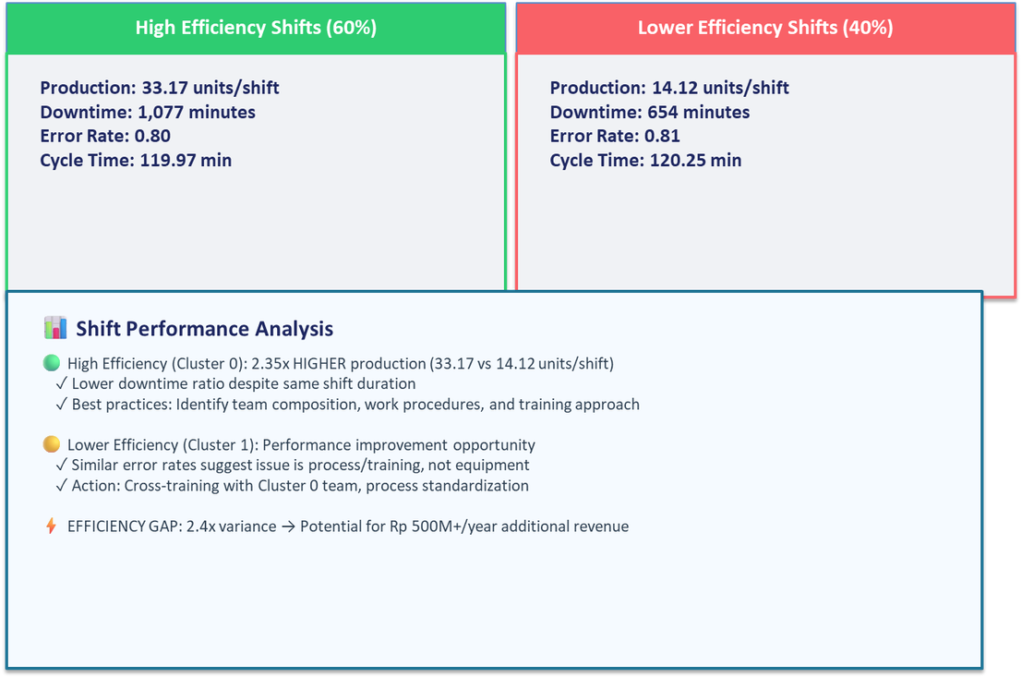
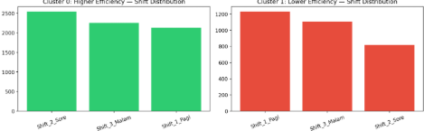
KEY FINDING 3 - SHIFT EFFICIENCY CLUSTERING

Slide 12
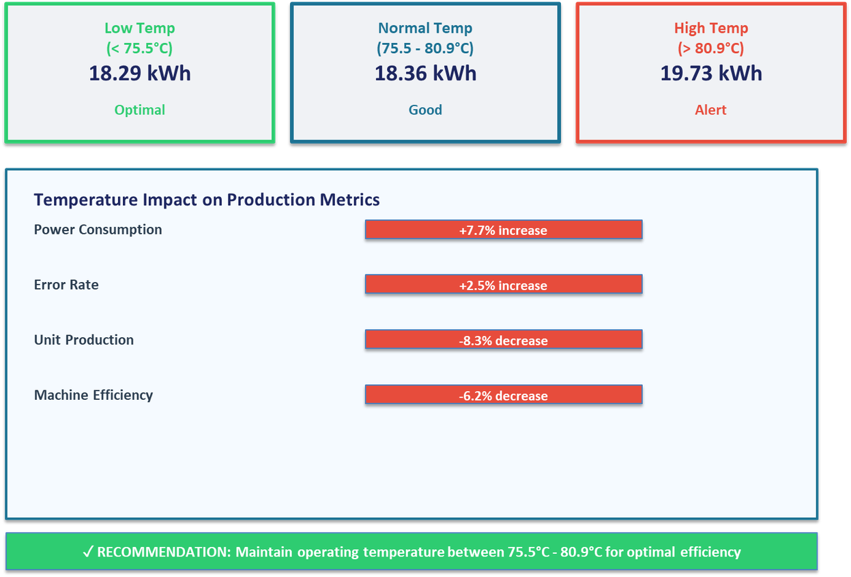
KEY FINDING 4 - SHIFT EFFICIENCY CLUSTERING
Findings: high temperature → power consumption increases, error rate increases, units produced decreases. Maintain operating temperature below Q3 for optimal efficiency.

Slide 13
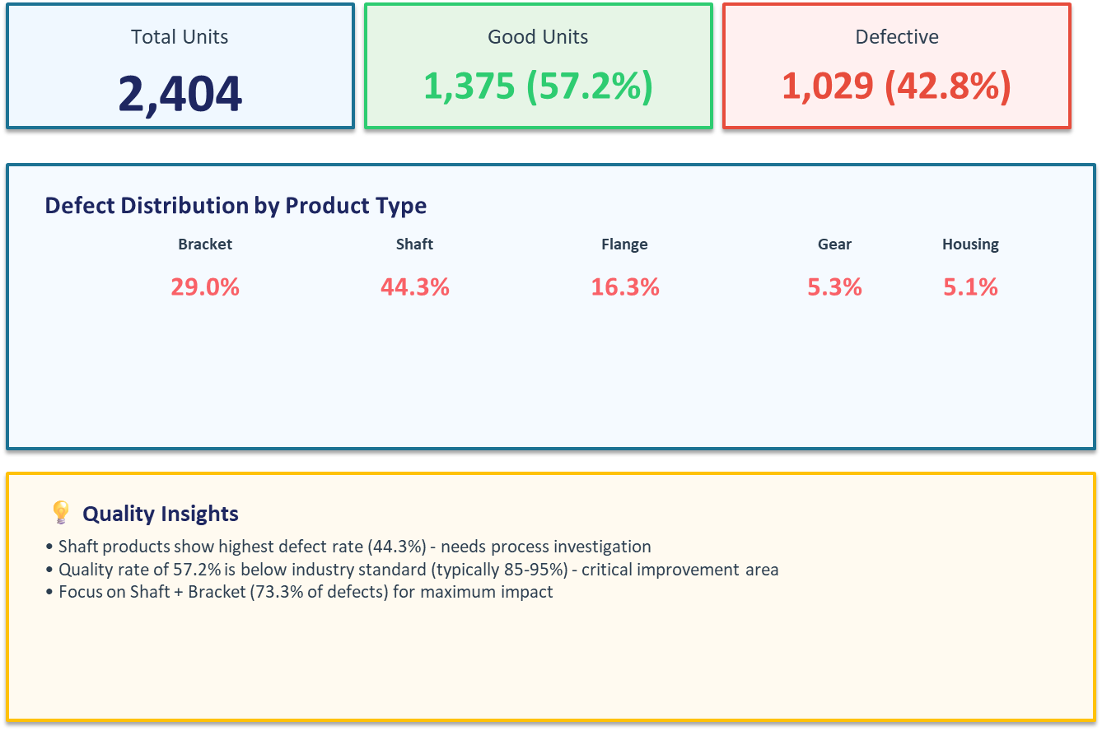
KEY FINDING 5 - QUALITY CONTROL

Slide 14
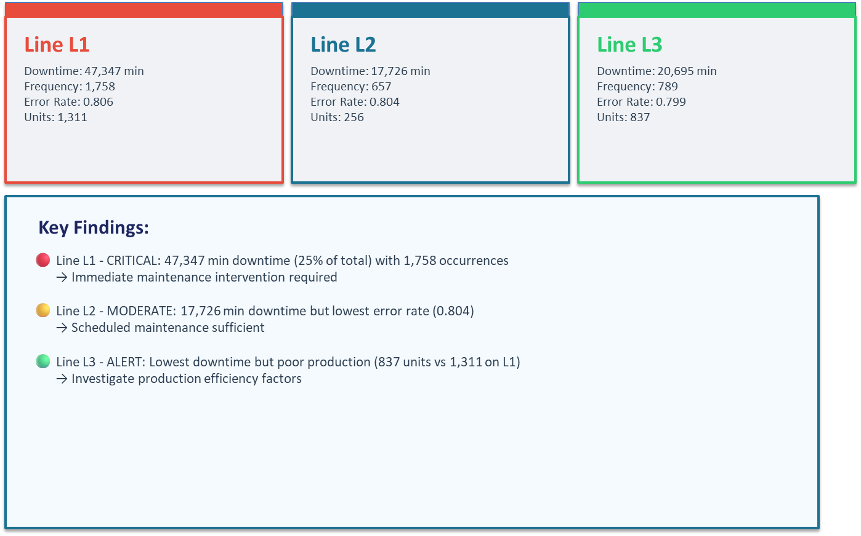
KEY FINDING 5 - PRODUCTION LINE PERFORMANCE

Slide 15
THANK YOU!
THANK YOU!
PRESENTED BY:
GURUH SUKMO

